Slide 1

Online health and community indicator platforms

Slide 2
What is an online health and community indicator platform?
Online sites that incorporate data management and data visualization
Data management
Involves the integration, measurement, analysis, and reporting of, in this case, population health based on a combination of in-depth first-party and third-party data.
Data visualization
Displaying health data in the form statistical graphics, plots and information graphics
Effective visualizations help users analyze and reason about data and evidence

Slide 3
What is the purpose of online health and community indicator platforms?
Easier access to nationally available raw data
Wider interest in making this data usable for different audiences (not simply healthcare systems)
Each platform seeks to engage its audiences with data through maps, charts, and tables.
These platforms offer a variety indicators on health outcomes and behaviors as well as indicators on social and economic factors, physical environment, and demographics.
In addition to data, many of the sites offer various features and services, such as case studies, reports, policy suggestions, and technical assistance.
The general motivations of these sites are similar, each one offers slightly different perspectives, indicators, tools, and frameworks to meet their intended audiences’ needs.

Slide 4
Elements of the Platforms
Data Tools
Data Content
Features & Services

Slide 5
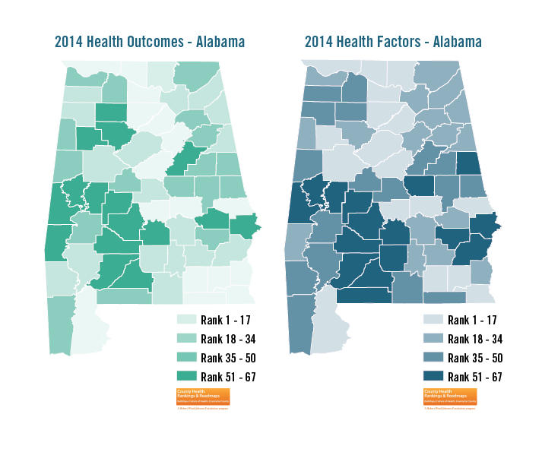
Data Tools:
Each site provides data tools and site’s target audience plays a role in the types and level of customizability of the tools.
Some websites guide users to predesigned data visualizations and offer minimal ability to customize views (well suited to users without technical expertise in analyzing data)
Other websites allow greater flexibility, enabling users to create custom maps, charts, and tabulations based on their needs
Most site have a mapping tool, interactive charts and graphs, and a web application for examining trend data

Slide 6
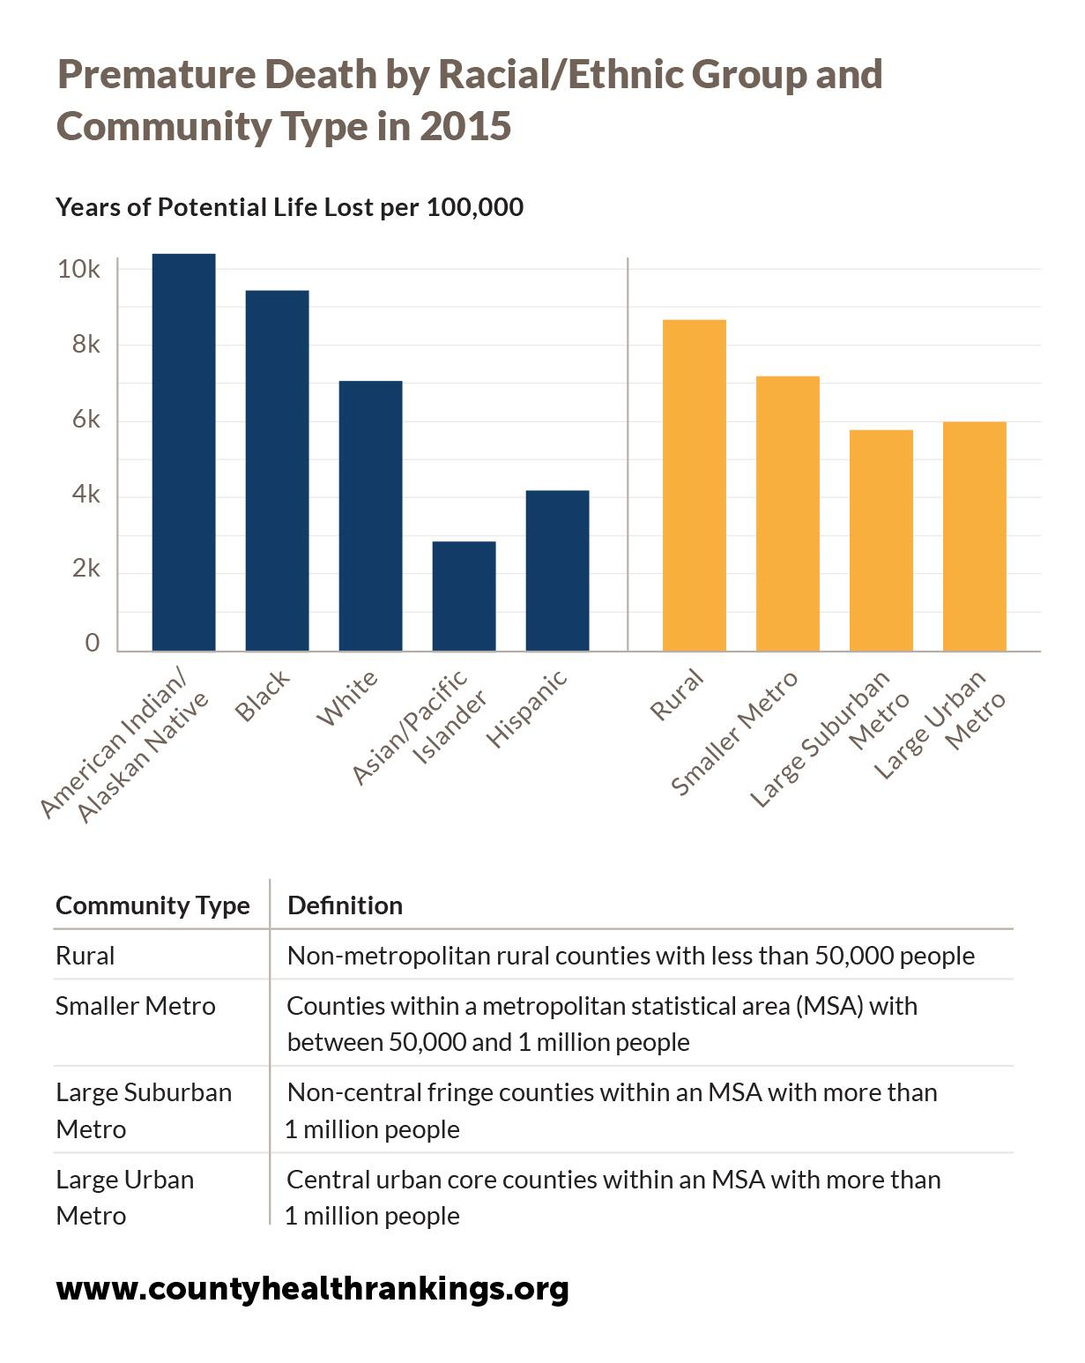
Data Content:
The data content of these platforms varies in terms of indicators, ways of organizing them, and geographies for their data.
Some websites included indicators that could be broken down by various subpopulations, like race/ethnicity, age, sex, nativity, and household composition; others did not.
The primary geographies for each website varied, but almost all focused on data below the state level.
Each platform has indicators generally that general fall into the categories of (1) health outcomes, (2) health behaviors, (3) clinical care, (4) social and economic, (5) physical environment, and (6) demographics.

Slide 7
Features & Services
Offer users additional ways ask questions; connect with the data through policy interventions, blog posts, and case studies; and get in-depth help through professional and technical services.
The features and services offered by websites can be the difference between users gathering data and information to educate themselves and users acting on the information they’ve learned.
Most sites have instructional information for users, supplemental materials, and technical assistance.

Slide 8
Example:
County Health Rankings & Roadmaps (CHR&R):
Offers a variety of county level data, tools, features and services for local community stakeholders and leaders.
CHR&R is used throughout the public health field and outside of traditional health sectors.
CHR&R's County Health Rankings informs communities on their health status and the broad range of factors that influence length and quality of life.
CHR&R provides evidence-based interventions and other tools for communities to better understand and utilize the Rankings data to improve health outcomes and the opportunities to be healthy.
CHR&R also provides coaching services for local communities on their health improvement journey.
Web link: http://www.countyhealthrankings.org/

Slide 9
Central Susquehanna Valley Community Platform
An approach that goes beyond the boundaries of health data
Focus on:
Social marketing
Communication and dissemination of reports on community need
Collaborative function
Data hub for social as well as health service organizations

