Slide 1
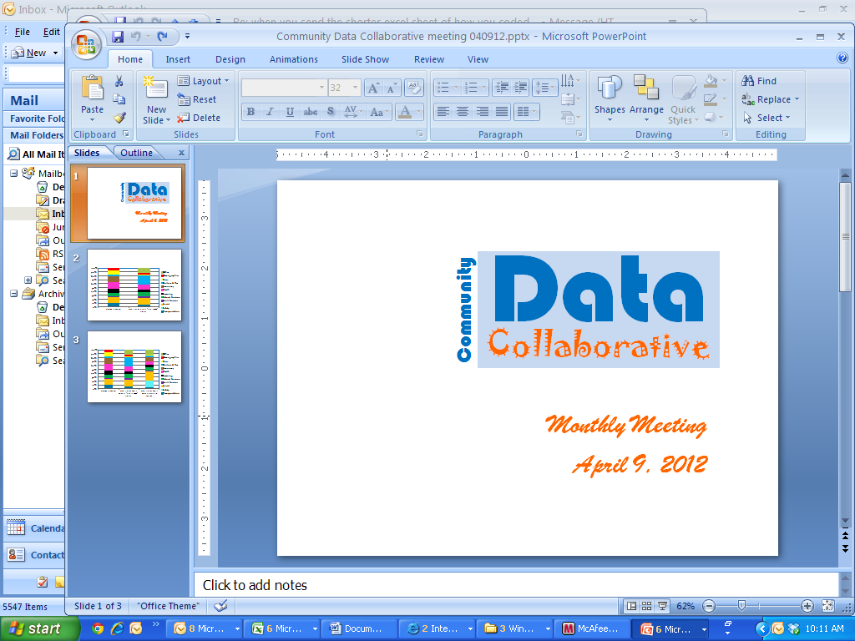
Monthly Meeting
May 21, 2012

Slide 2
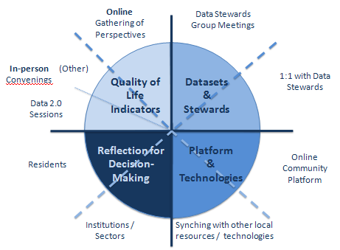
Agenda
Introductions
Developing Platform/Technologies
  Why create a platform focused on neighborhoods?
Developing Datasets
  Natural Environment:
    Sarasota County Green Map / Open Green Map
    Impervious Surface & Watershed Well-Being
Clarifying Quality of Life Indicators
  Which affect life in neighborhoods, and which variables are neighbors likely to affect?
Reflection & Decision-Making
  How is reflection on community data informing resident-led efforts?
Announcements

Slide 3
Developing a Community Data Platform
Online Gathering of Perspectives
Data Stewards Group Meetings
In-person Convenings
(Other)
Quality of Life Indicators
Datasets
&
Stewards
1:1 with Data Stewards
Data 2.0 Sessions
Reflection for
Decision-Making
Platform
&
Technologies
Online Community Platform
Residents
Institutions / Sectors
Synching with other local resources / technologies

Slide 4
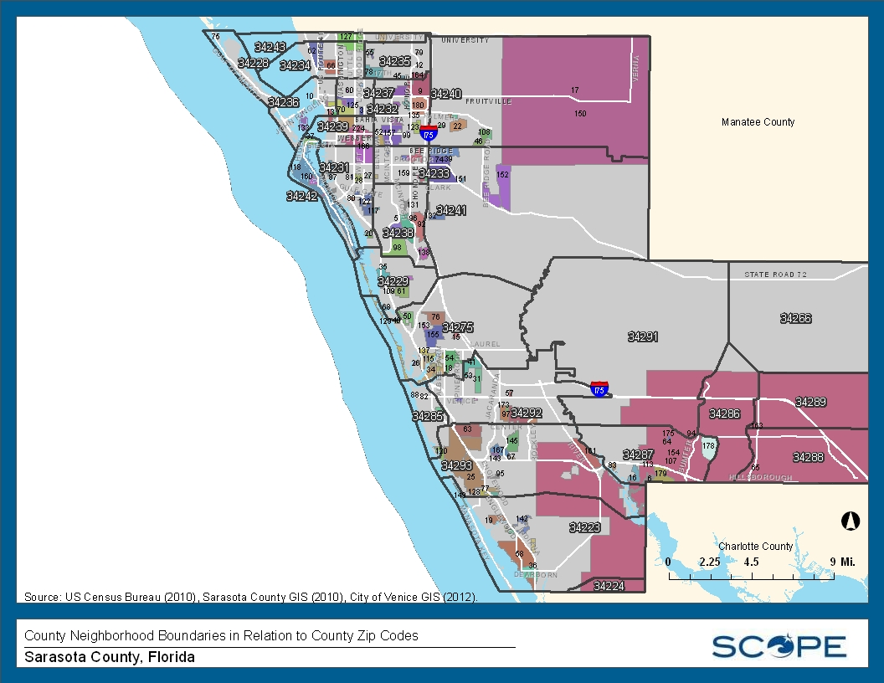
Zip Codes (in Relation to Neighborhoods)

Slide 5
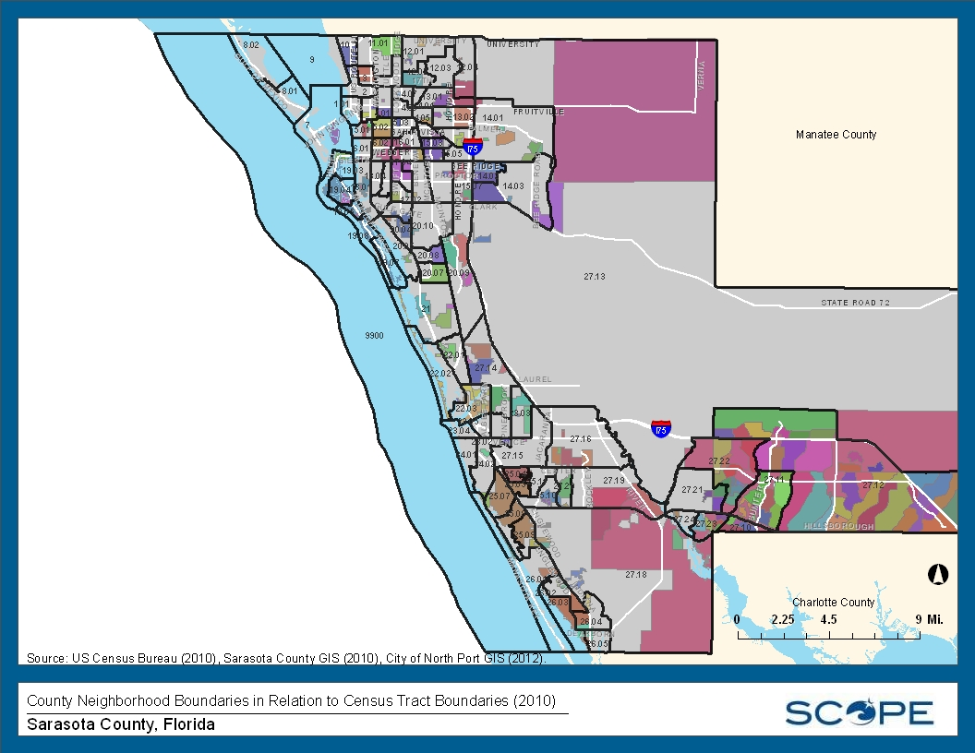
Census Tract 2010 Boundaries in Relation to Neighborhoods

Slide 6
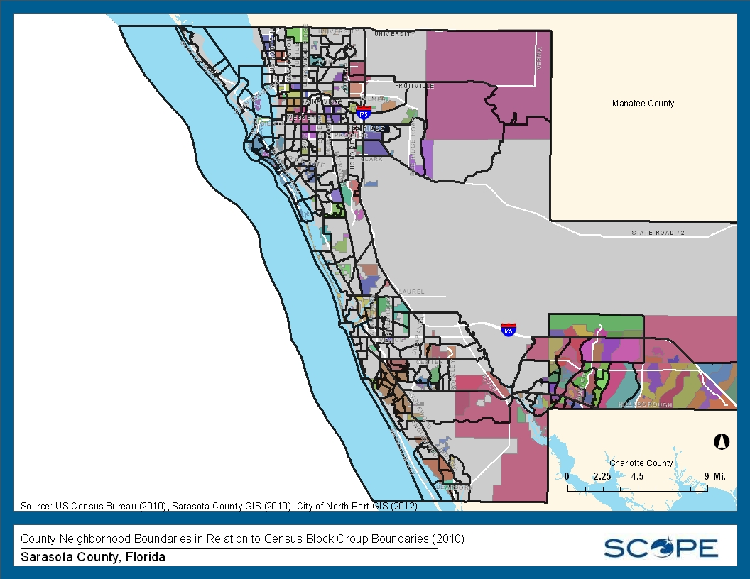
Census Block Group Boundaries in Relation to Neighborhoods

Slide 7
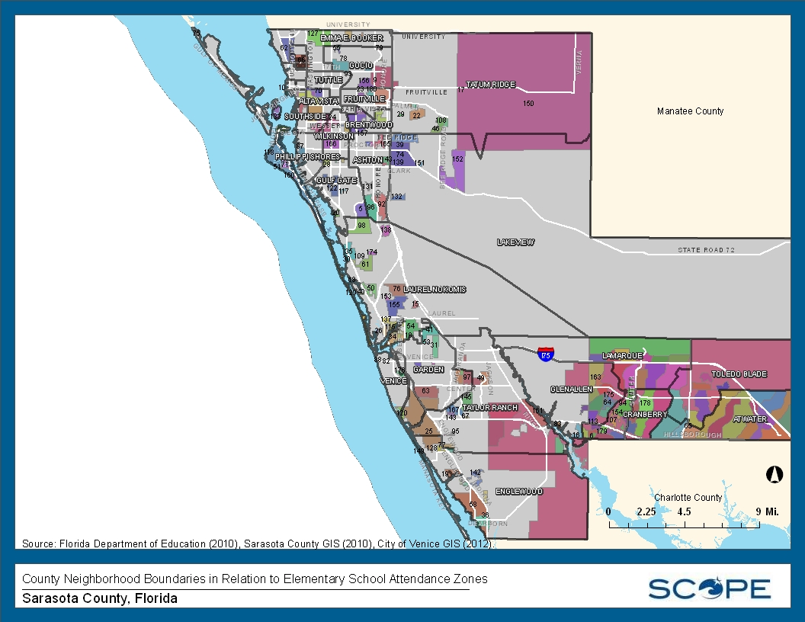
Elementary School Attendance Zones in Relation to Neighborhoods

Slide 8
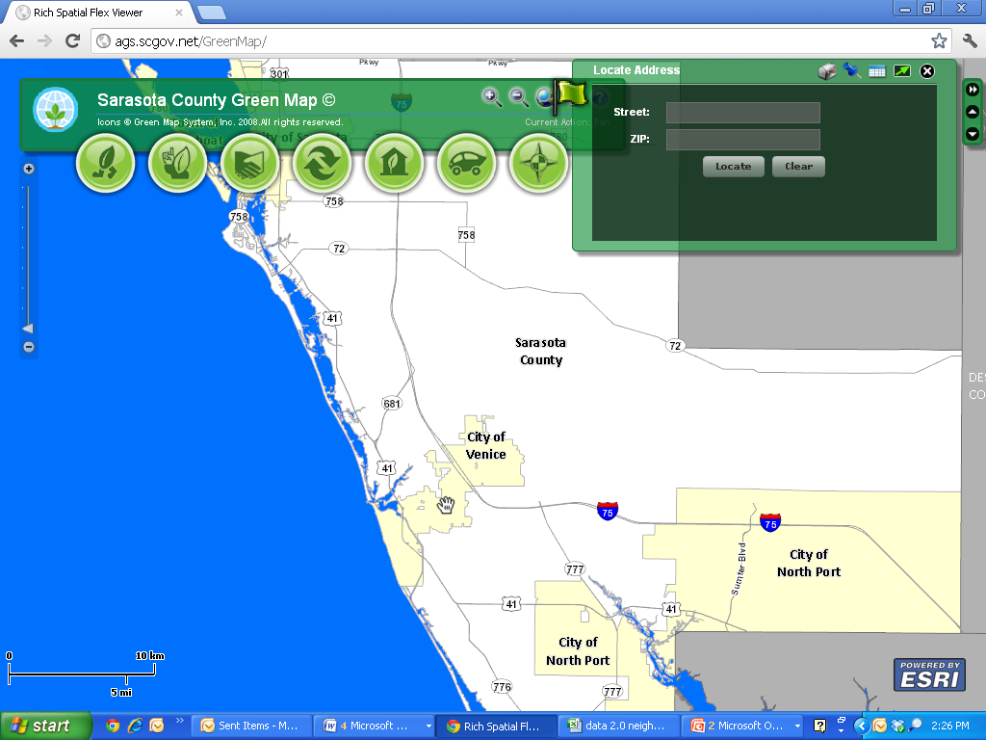
Green Map

Slide 9
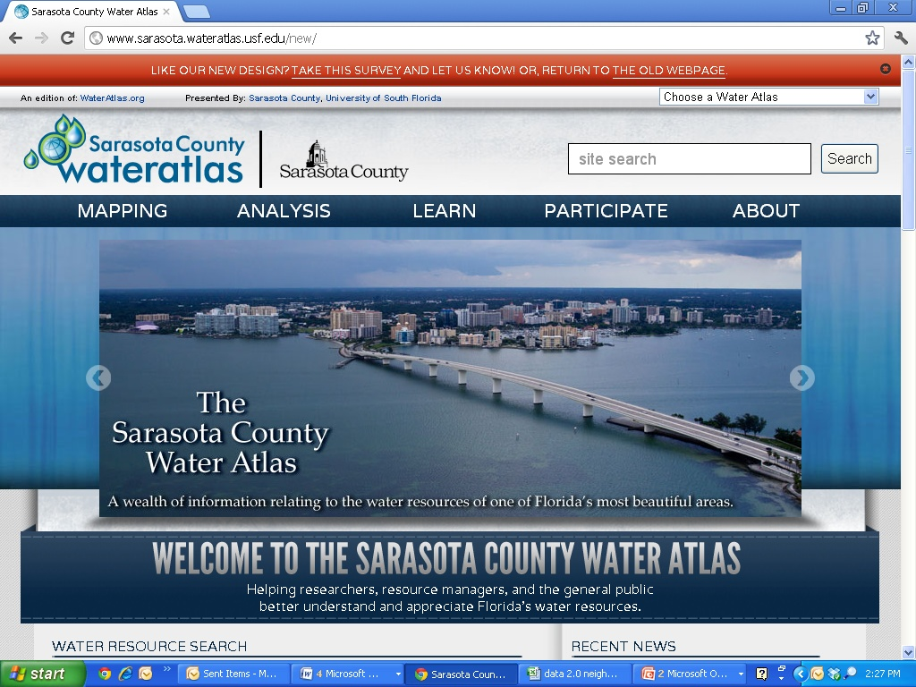
Water Atlas

