Slide 1
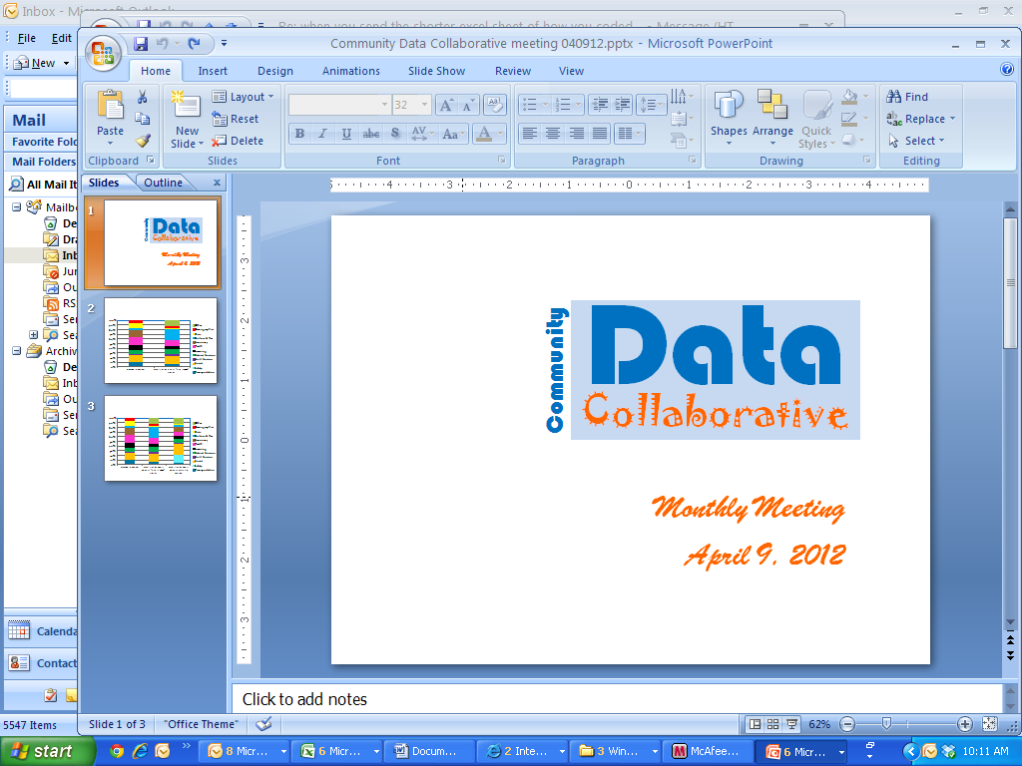
Monthly Meeting
June 25, 2012

Slide 2
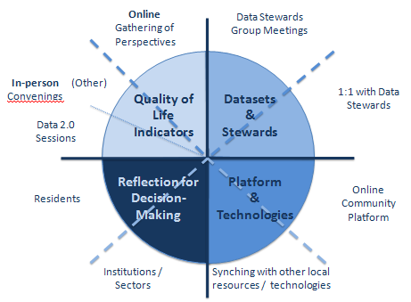
Agenda
Introductions
DATASETS
  Update on data contributed so far & data in cue for conversion
ONLINE PLATFORM
  Preliminary framework for neighborhood comparisons
  Anticipating platform comparisons for local platform selection
CLARIFYING QUALITY OF LIFE INDICATORS
  Upcoming Community Data 2.0 sessions
  Update on Life is Good video stories
REFLECTION
  RCC Fellowship & Community of Practice
Review of timeline for upcoming 3 months
Announcements – Setting next meeting – Monday, July 23, 11 – 12:30

Slide 3
Developing a Community Data Platform
Online Gathering of Perspectives
Data Stewards Group Meetings
In-person Convenings
(Other)
Quality of Life Indicators
Datasets
&
Stewards
1:1 with Data Stewards
Data 2.0 Sessions
Reflection for
Decision-Making
Platform
&
Technologies
Online Community Platform
Residents
Institutions / Sectors
Synching with other local resources / technologies

Slide 4
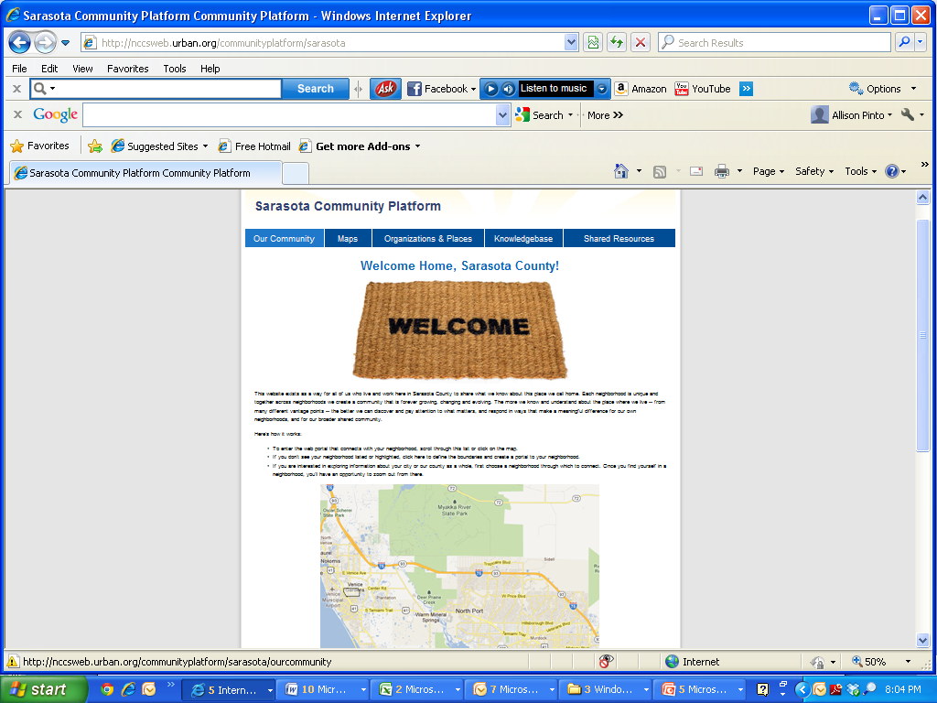
DATASETS: What We’ve Got So Far for the Online Community Data Platform

Slide 5
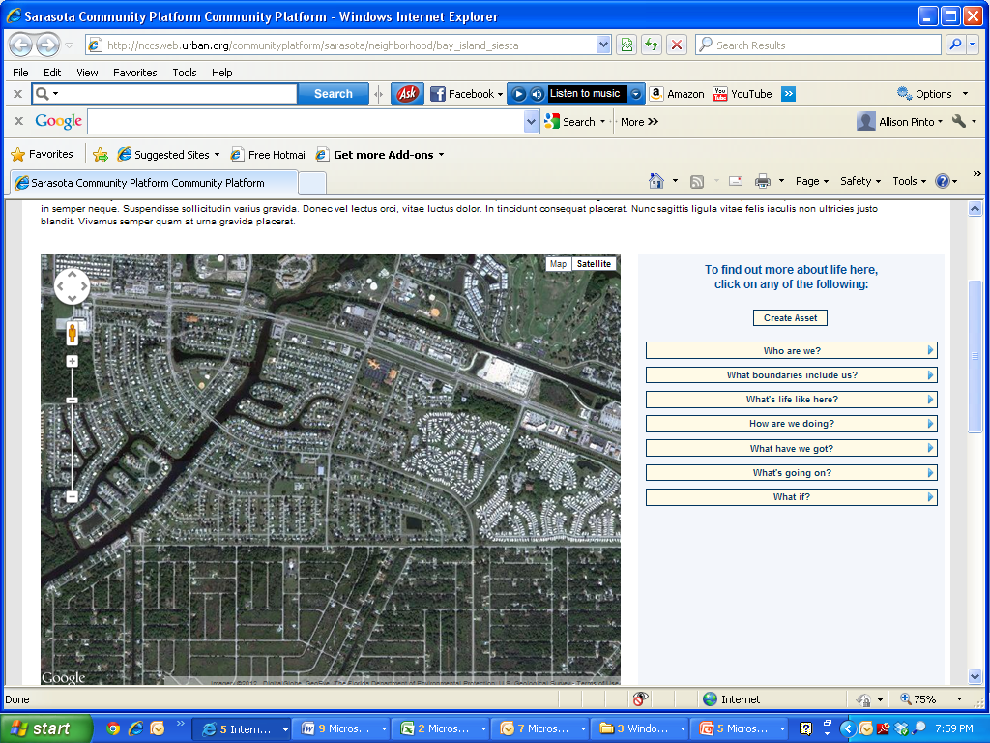
Online Community Data Platform

Slide 6
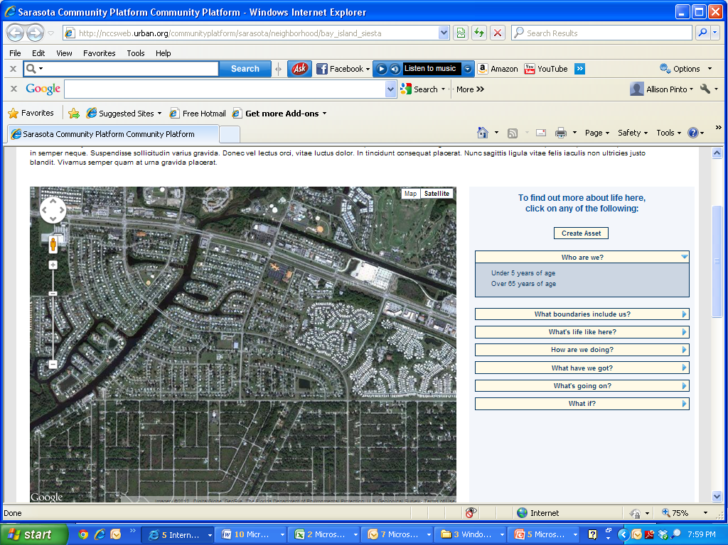
Online Community Data Platform
-Total population
-Population density per square mile
-Age
-Under 5 years of age
-Under 18 years of age
-Over 65 years of age
Race / Ethnicity
  -Percent of population who identifies as Black or African American
  -Percent of population who identifies as White
  Percent of population who identifies as Latino or Hispanic
-Total households
-Male head of household
-Female head of household
-Average household size
-Age of householder

Slide 7
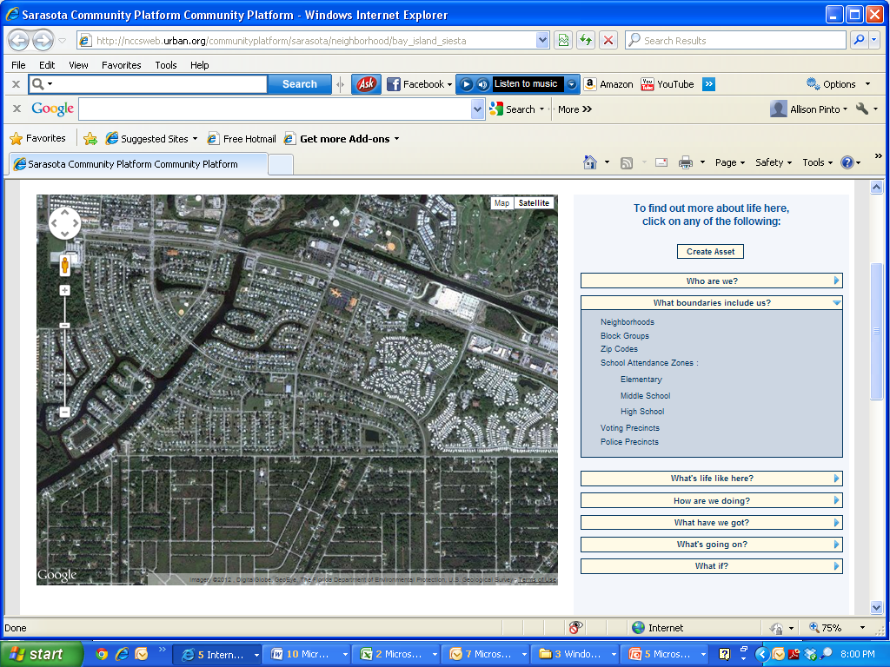
Online Community Data Platform
-Neighborhoods
-Census Blocks
-Census Block Groups
-Census Tracts
-Zip Codes
-School Attendance Zones:
-Elementary School
-Middle School
-High School
-Voting Precincts (2012)
-Police Precincts

Slide 8
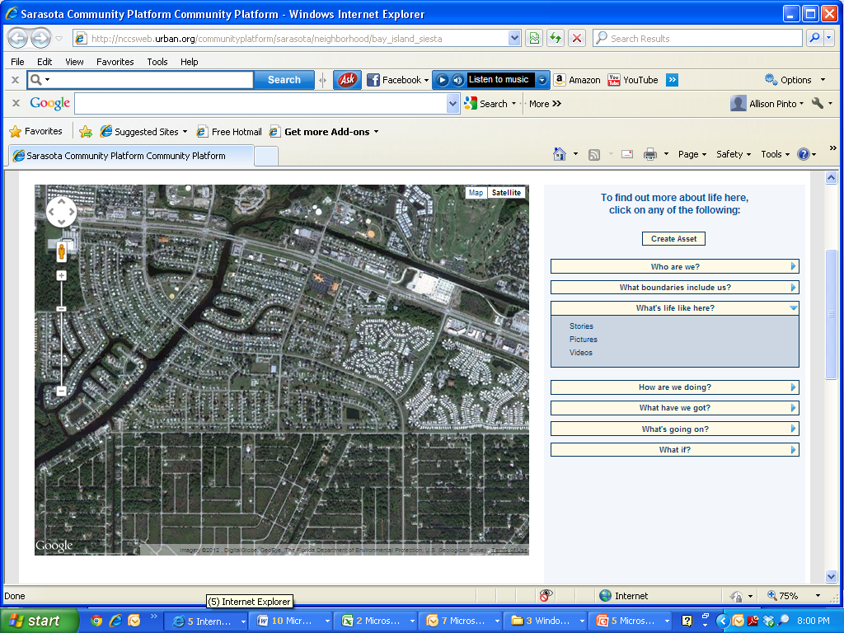
Online Community Data Platform

Slide 9
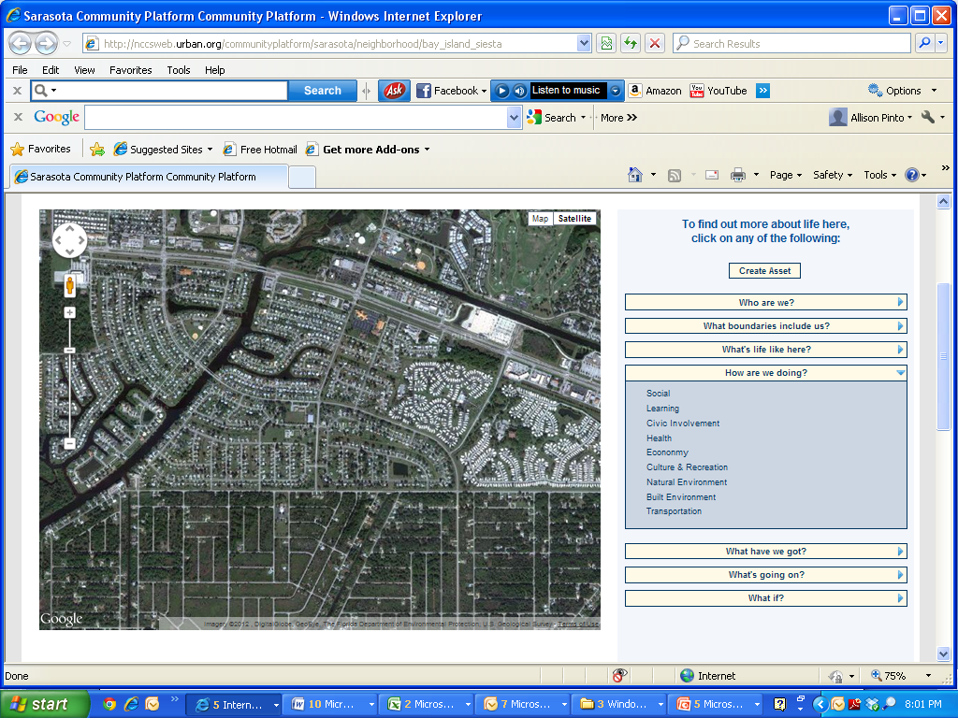
Online Community Data Platform

Slide 10
Online Community Data Platform
Social
Learning
-School Attendance
-3rd Grade Reading Achievement
-10th Grade Reading Achievement
-High School Graduation
Civic Involvement
-Registered Voters
-Age of Registered Voters

Slide 11
Online Community Data Platform
Health
Low Birth Weight
Infant Mortality
Other?

Slide 12
Online Community Data Platform
Economy
-Percent Unemployed
-Median Family Income

Slide 13
Online Community Data Platform
Natural Environment
-Impervious surfaces
-community gardens, farmers' markets, etc
-NEST sites
-Florida-friendly yards
-rain barrels
-green businesses
-chemical collection
-waste pick-up
-energy STAR buildings
-LEED Certified buildings
-Solar Installations
-Alternative transportation

Slide 14
Online Community Data Platform
Built Environment
-Percent of renter occupied homes
-Percent of owner occupied homes
-Occupied housing units
-Vacant housing units

Slide 15
Online Community Data Platform
Built Environment
-Percent of renter occupied homes
-Percent of owner occupied homes
-Occupied housing units
-Vacant housing units
Transportation

Slide 16
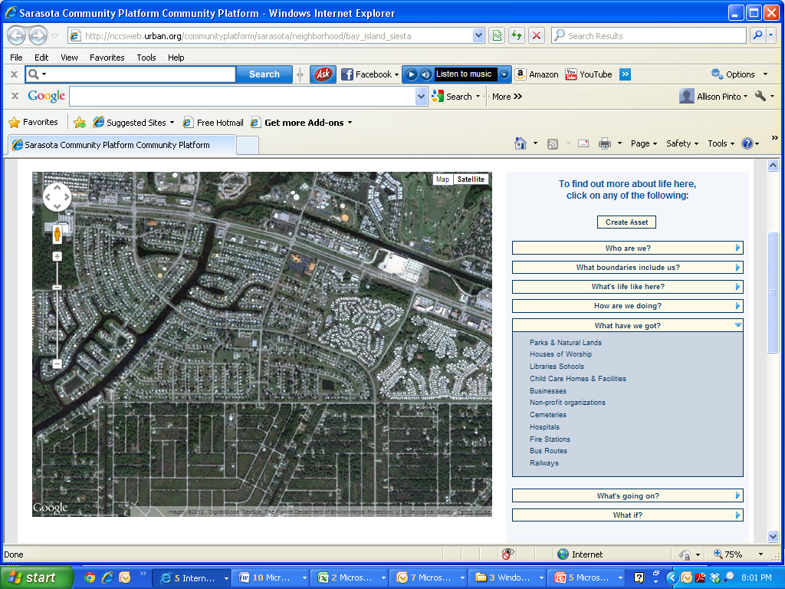
Online Community Data Platform
-Parks & Natural Lands
-Houses of Worship
-Libraries
-Schools
-Businesses
-Nonprofit Organizations
-Hospitals
-Fire Stations
-Bus Routes
-Railways

Slide 17
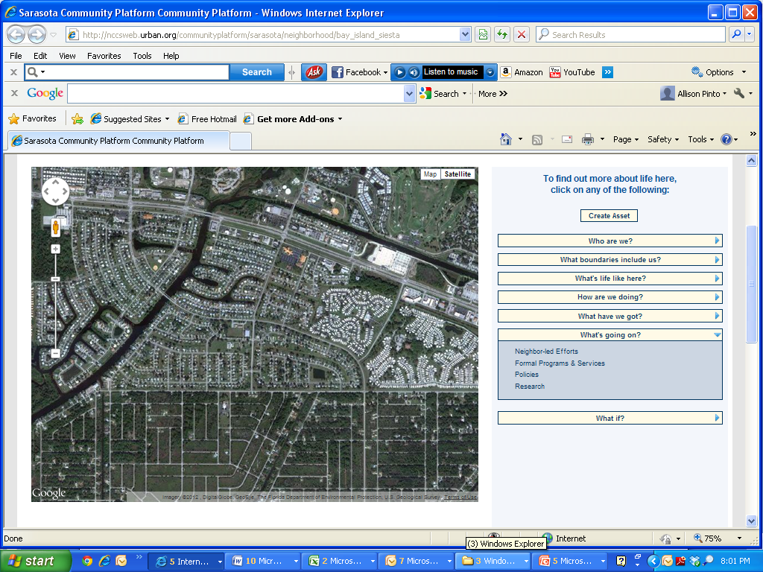
Online Community Data Platform

Slide 18
Online Community Data Platform

Slide 19
THE PLATORM: The Challenge of County-Wide Comparisons
How to compare neighborhoods to all other areas of Sarasota County when not all areas have been identified as part of a neighborhood so far…

Slide 20
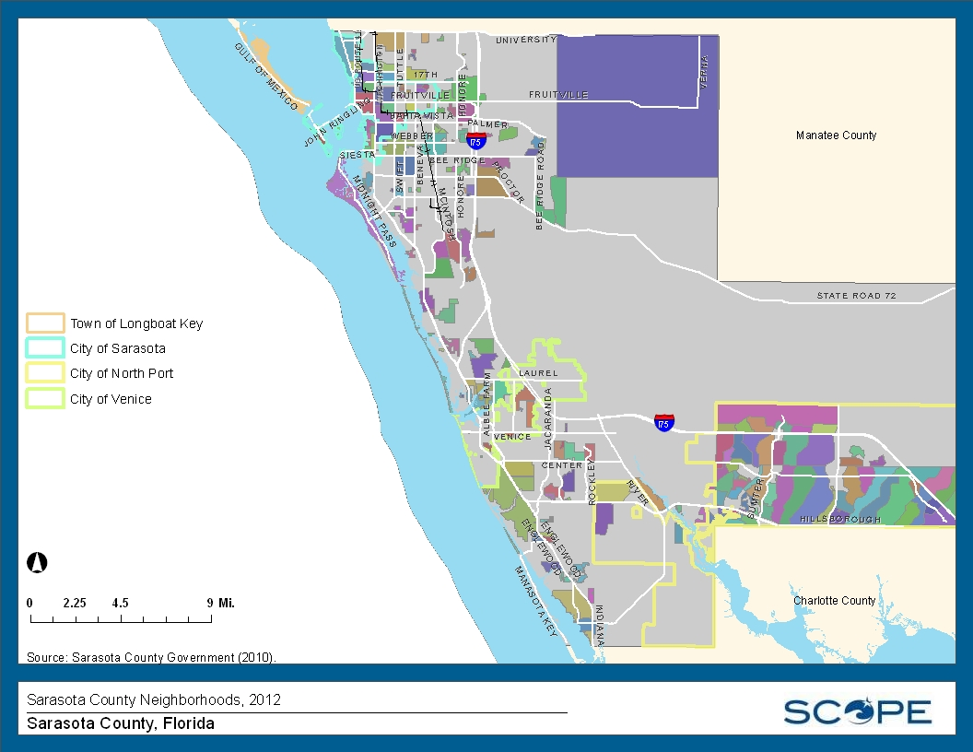
Neighborhoods Identified So Far

Slide 21
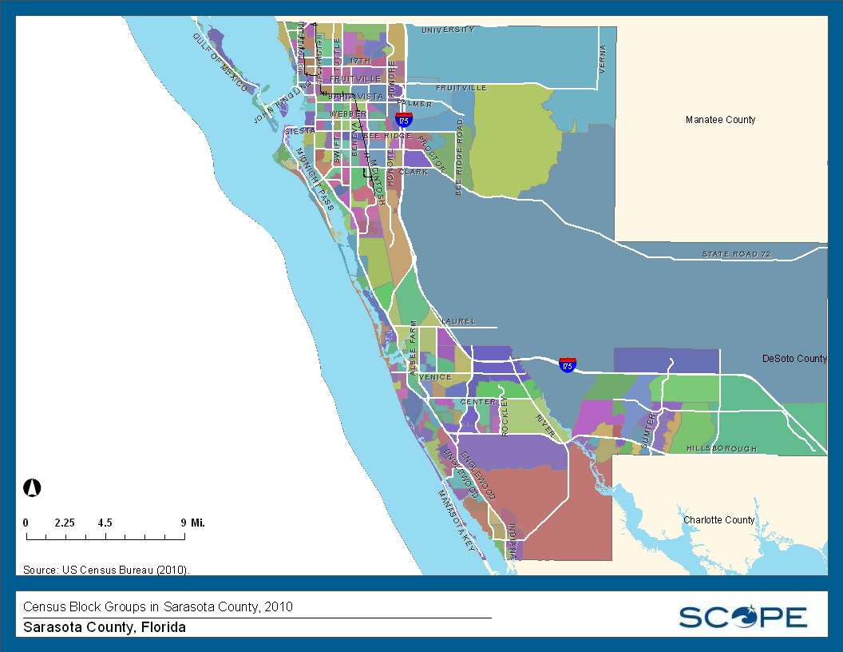
Alternative to Neighborhoods:
Census Block Groups

Slide 22
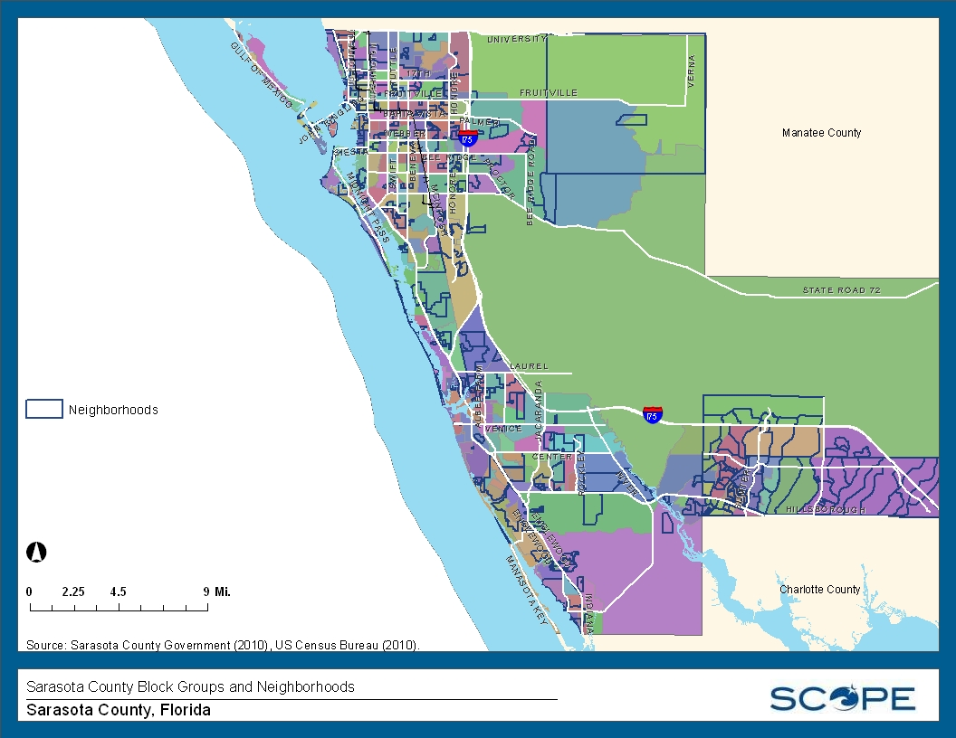
Alternative to Neighborhoods:
Census Block Groups

Slide 23
THE PLATFORM:
Preparing for Platform Comparisons
Spreadsheet with:
Name / Website
Host / Partners
General Description
Included Indicators (with emphasis on neighborhood scale)
Smallest Geography
Data Frequency
Data Visualization Features
Interactive Features
Other Noteworthy Aspects

Slide 24
CLARIFYING QUALITY OF LIFE INDICATORS
Data 2.0 Workshops
  Data 2.0: A Neighborkids’ Perspective
  Saturday, July 14 - 9 a.m. to 1 p.m. - Robert L. Taylor Complex
  Data 2.0: Sarasota
  Mid- August – Date/Time/Location TBD
  Data 2.0: An Older Adults’ Perspective
  Late August – Date/Time/Location TBD
“Life is Good” Community Videos
  Sarasota County Libraries
  Other Partners?

Slide 25
REFLECTION ON COMMUNITY DATA
Resident Community Changemakers
  Fellows
  Community of Practice
“Just-in-Time” Opportunities for Reflection
  Redistricting
  Other?

Slide 26
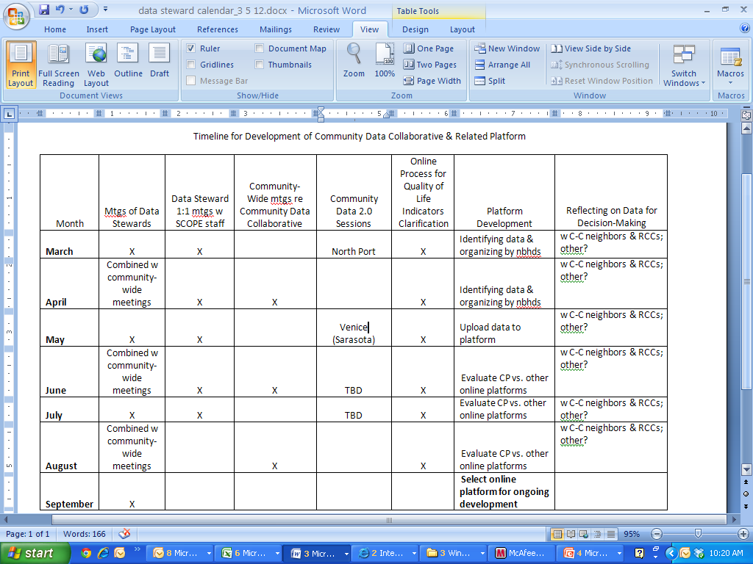
TIMELINE FOR UPCOMING 3 MONTHS

Slide 27
Final Announcements

