Slide 1
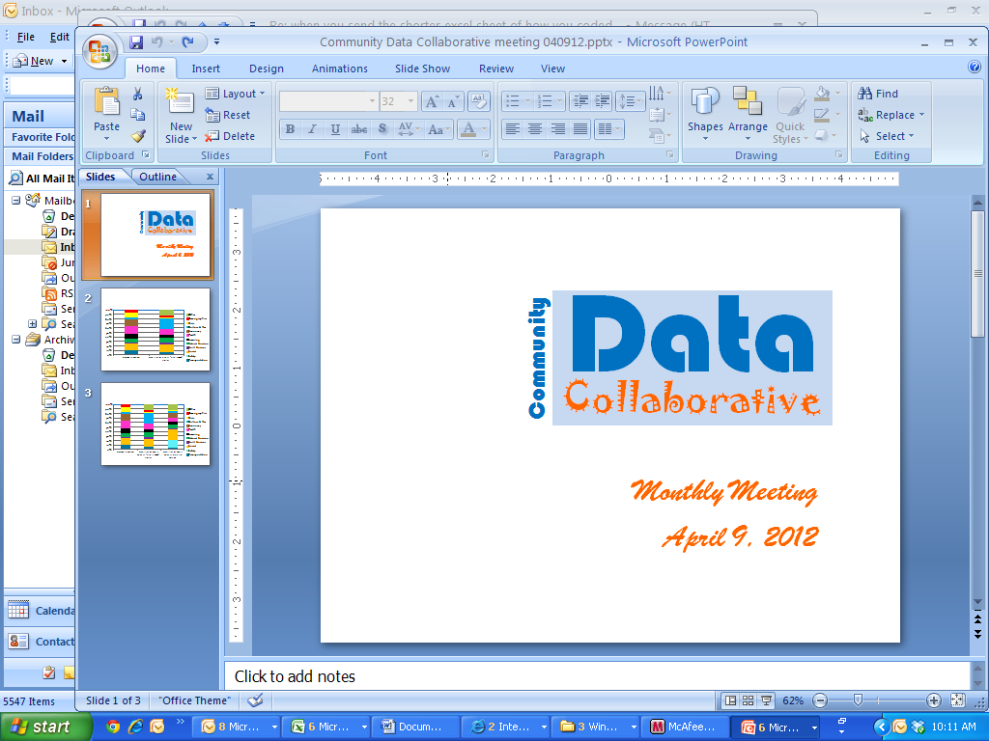
Monthly Meeting
April 9, 2012

Slide 2
Agenda
Introductions
PLATFORM/TECHNOLOGIES:
  Update re: collaboration with Urban Institute
DATASETS
  Address dataset conversion -- for sorting by neighborhoods
QUALITY OF LIFE INDICATORS
  Life is Good video stories
  Upcoming Community Data 2.0 sessions
REFLECTION
  RCC Community of Practice
Announcements – Setting next meeting

Slide 3
Developing a Community Data Platform
Online Gathering of Perspectives
Data Stewards Group Meetings
In-person Convenings
(Other)
Quality of Life Indicators
Datasets
&
Stewards
1:1 with Data Stewards
Data 2.0 Sessions
Reflection for
Decision-Making
Platform
&
Technologies
Online Community Platform
Residents
Institutions / Sectors
Synching with other local resources / technologies

Slide 4
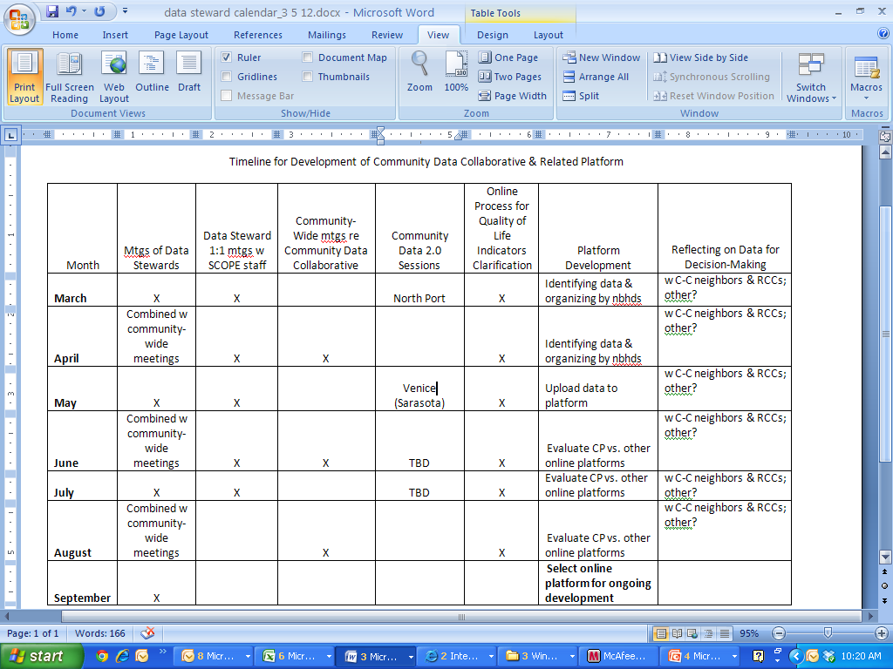

Slide 5
Collaboration with Urban Institute
Finalize contract
Upload local datasets by address/neighborhood
“Inhabit” several neighborhood pages

Slide 6
Address Dataset Conversion
ID# | Street Address | City | State | Zip

Slide 7
Clarifying Qualities of Life that Matter in Sarasota County
Life is Good Video Stories

Slide 8
Outline
Purpose
Methods
Quick summary of findings
  Examples
Caveats
Questions

Slide 9
Purpose
Furthering the identification of Quality of Life indicators that matter most to citizens of Sarasota County.

Slide 10
Developing a Community Data Platform
Online Gathering of Perspectives
Data Stewards Group Meetings
In-person Convenings
(Other)
Quality of Life Indicators
Datasets
&
Stewards
1:1 with Data Stewards
Data 2.0 Sessions
Reflection for
Decision-Making
Platform
&
Technologies
Online Community Platform
Residents
Institutions / Sectors
Synching with other local resources / technologies

Slide 11
Method
“Life is Good” stories were gathered on video
Stories were coded by domains of well-being
Story-teller home addresses have been mapped
Notes:
“Life is Good” stories were gathered on video from people throughout Sarasota County: online invitations and in-person
“Tell us a story about a moment you experienced here in Sarasota County when you thought to yourself, “Wow! Life is GOOD here in Sarasota County!”
Stories were coded by domains of well-being
Story-teller home addresses have been mapped by census tract.

Slide 12
Quick summary of findings
Total # of stories: 35
Notes:
Through the stories that have been contributed, we have coded stories by quality of life indicators. The quality of life indicators that are referred to most often in stories (culture/rec, social, health, natural environment) are not currently not measured as often as some of the other indicators.
-Data isn’t really available yet at a broad scale (so far 34 stories have been contributed about Sarasota County).

Slide 13
Quality of Life Indicators
Indicators identified through this process were different from those we currently measure

Slide 14
Quality of Life Indicators

Slide 15
Quality of Life Indicators

Slide 16
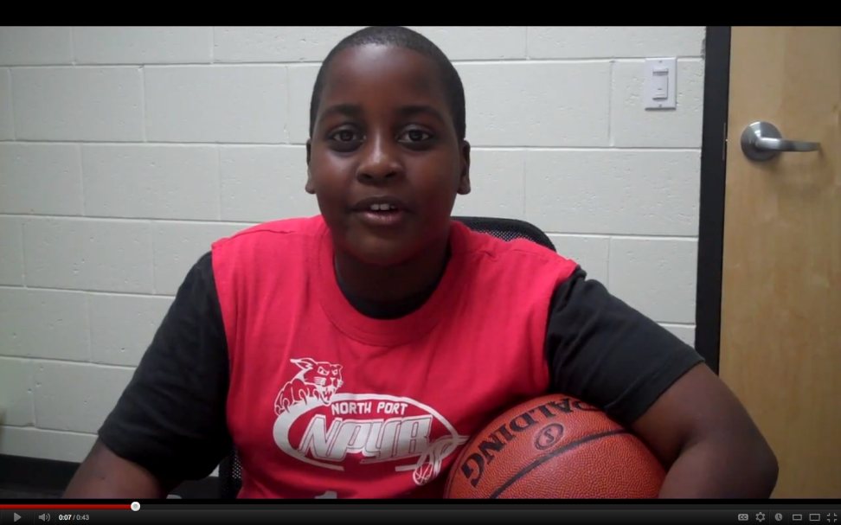
Findings
Many stories about recreational indicators
Thomas’ story:

Slide 17
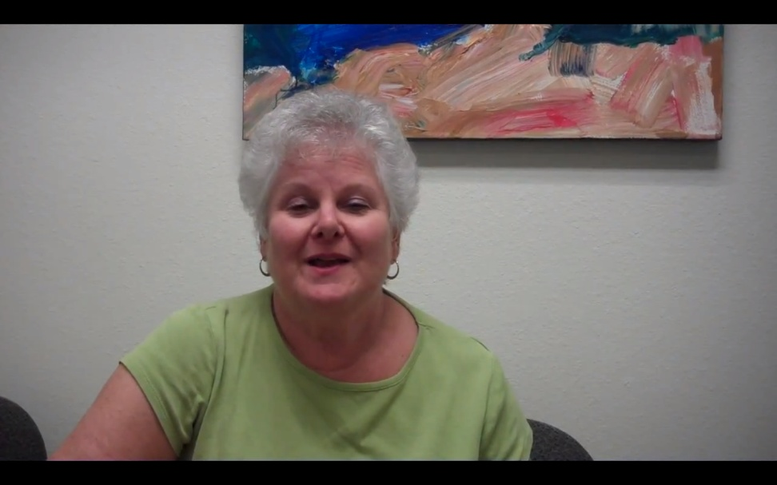
Findings
Overlap: stories that referred to social indicators often referred to cultural indicators
Ruth’s story:

Slide 18
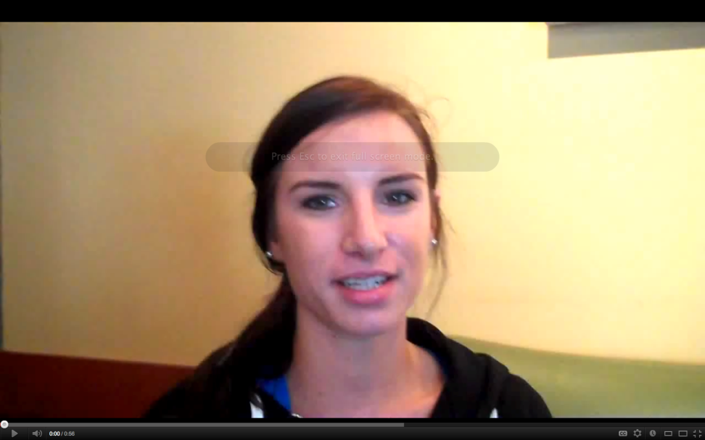
Findings
Overlap: stories that referred to recreational indicators often referred to natural environment indicators as well.
Brittny’s story:

Slide 19
Caveats
Only 35 stories so far
Inconsistency of prompt
Not coded by the story-tellers

Slide 20
Questions
Who are potential partners in the most frequently identified domains(culture, rec, social)?
How could this process best contribute to the efforts of the Community Data Collaborative?
Who else is interested in developing this process?

Slide 21
Reflection
Final Announcements

Slide 22
Final Announcements

